Slide 1

Neurons, stimuli and receptors
GTHBY Human Biology

Slide 2
Review
What is the function of the CNS?
What is the function of the PNS?
Name the two sub-systems of the PNS
Give an example of an autonomic sympathetic effect.
Give an example of a somatic motor effect.

Slide 3
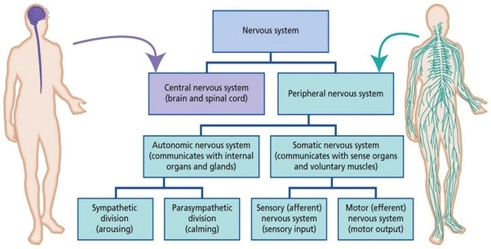

Slide 4
Learning Intentions
Examples of stimuli and the types of receptors that detect them
Location of the different receptors in the human body

Slide 5
Success Criteria
Classify neurons as sensory, motor and interneuron, by diagram or description of function
List stimuli and identify the receptor that senses them.
List receptors and their location in the body

Slide 6
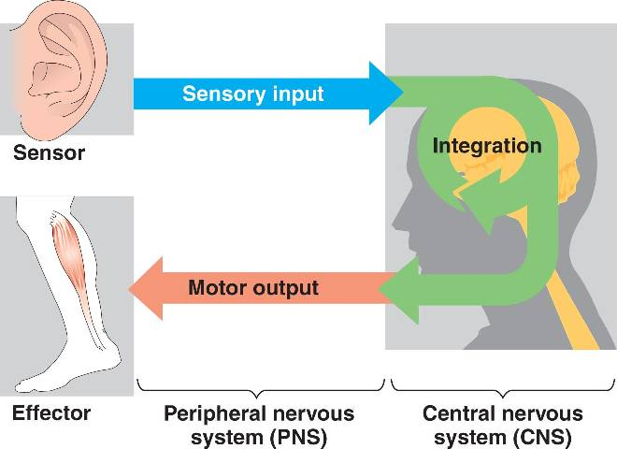
Primary Functions
Sensory (afferent) neurons
Interneurons
Motor (efferent) neurons

Slide 7
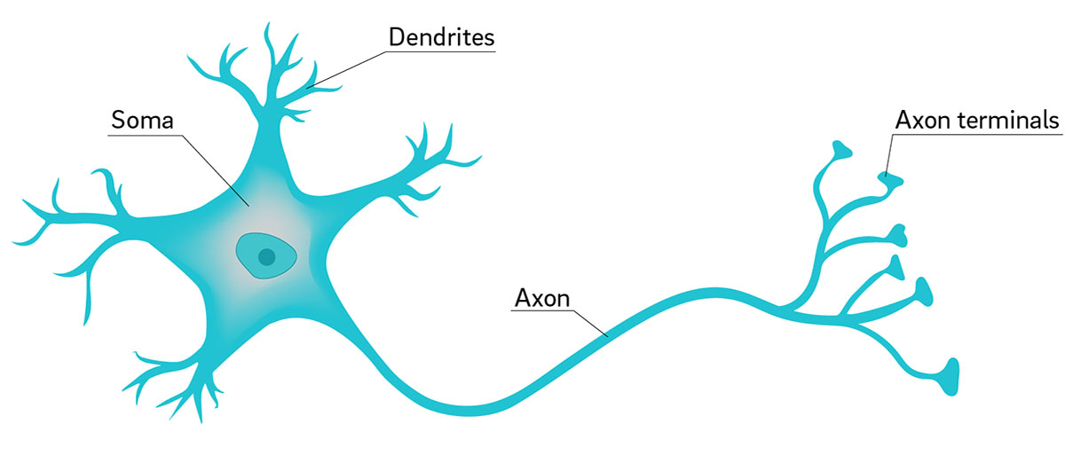
Parts of a neuron
Dendrites: fibres that receive and convey messages to cell body
Soma (cell body): metabolic centre of the cell (contains the nucleus)
Axon: fibres that conduct impulses away from the cell body
Axon terminal: branching fibres at the end of the axon, contain vesicles filled with neurotransmitters
Direction of impulse ------→

Slide 8
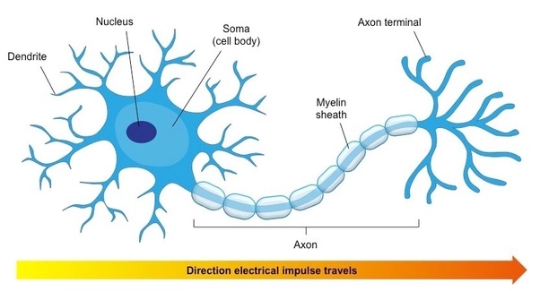
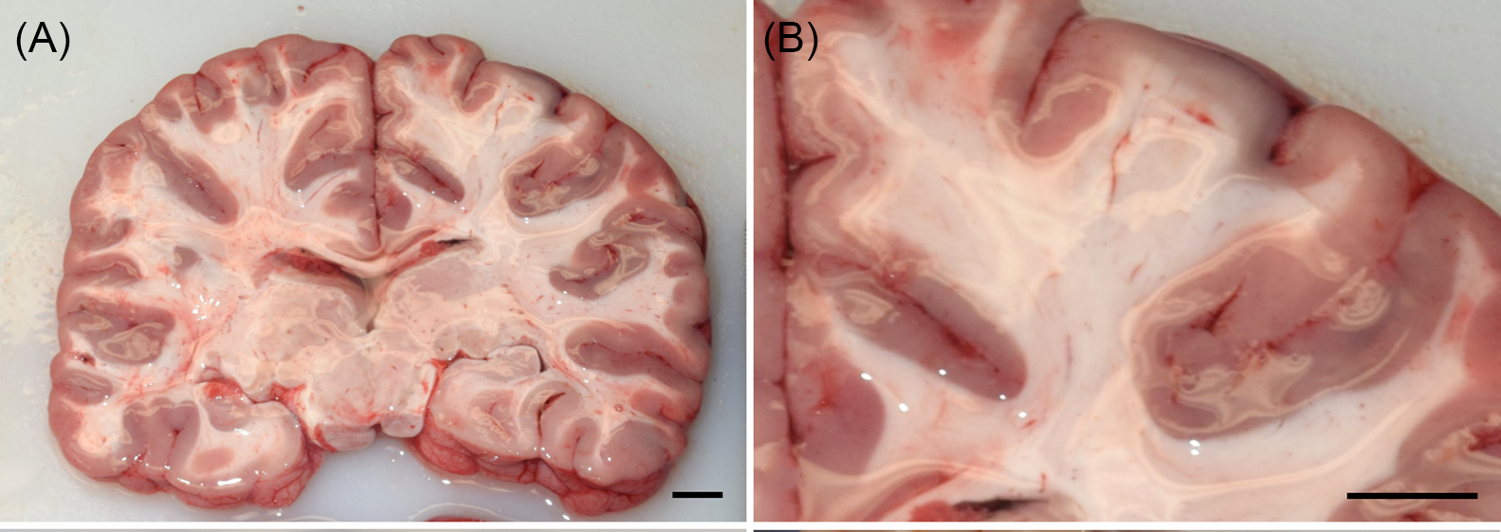
Myelin sheath
Some neurons have a covering of whitish, fatty material called myelin, which insulates the nerve fibre and increases the rate of transmission of the nerve impulse

Slide 9
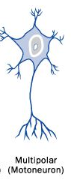
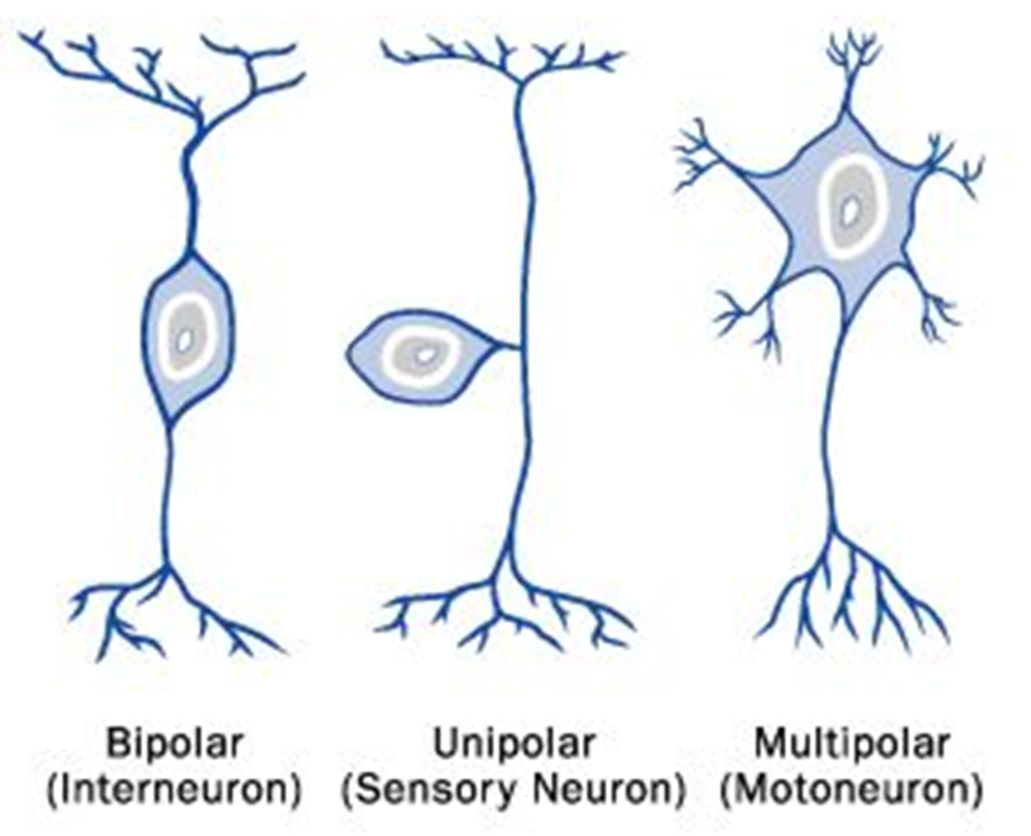
Classification of neurons

Slide 10
Stimuli and receptors
Senses provide information about the body and its environment
Humans have five special senses:
olfaction (smell)
gustation (taste)
equilibrium (balance and body position)
vision
hearing

Slide 11
Additionally, we possess general senses, also called somatosensation, which respond to stimuli like temperature, pain, pressure, and vibration.
spatial orientation
balance
proprioception (position of bones, joints, and muscles), and the sense of limb position

Slide 12
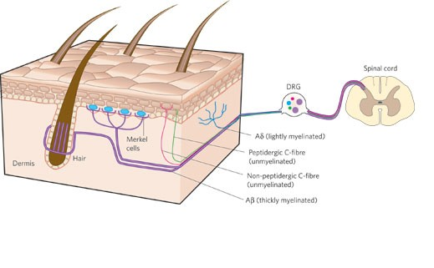
Although the sensory systems associated with these senses are very different, all share a common function: to convert a stimulus (such as light, or sound, or the position of the body) into an electrical signal in the nervous system.

Slide 13
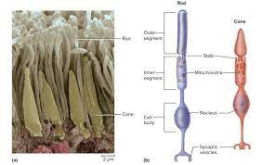
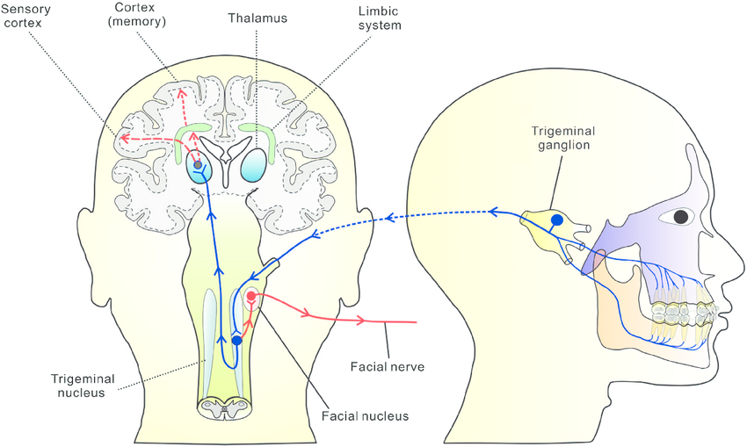
Sensory receptors
Some receptors are specialised to respond to a specific stimulus, eg light and sound vibrations have special receptor cells.
Others have free nerve endings that respond to different stimuli, such as pain receptors in your gums and teeth may be stimulated by temperature changes, chemical stimulation, or pressure.

Slide 14
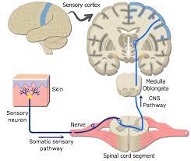
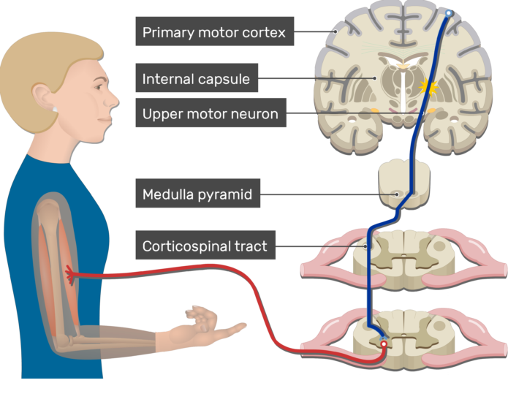
The neural connections

Slide 15
Success Criteria
Classify neurons as sensory, motor and interneuron, by diagram or description of function
List stimuli and identify the receptor that senses them.
List receptors and their location in the body

